Slide 1
MIS 7720 #2 Intelligent Agents

Slide 2
Artificial Intelligence
The science of making machines/systems that…
Think like humans
Act like humans
Think rationally
Act rationally
Notes:
https://en.wikipedia.org/wiki/Turing_test

Slide 3
Integrating approaches
Beyond a specific approach
Intelligent agents
An intelligent agent is a system that perceives its environment and takes actions which maximize its chances of success.
The simplest intelligent agents are programs that solve specific problems.
More complicated agents include human beings and organizations (such as firms).

Slide 4
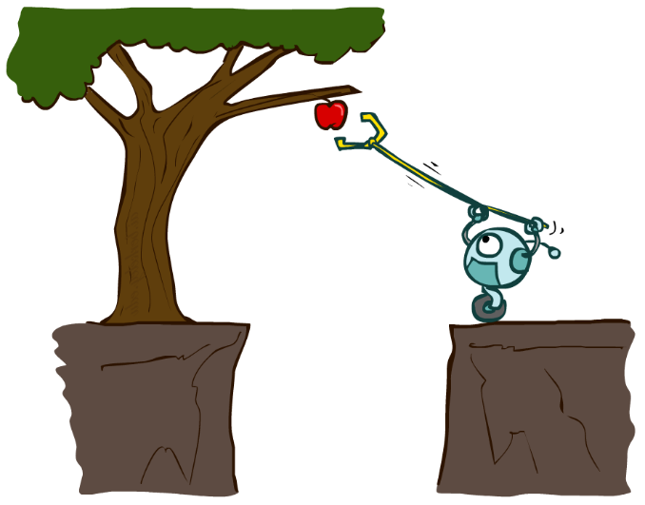
Rational Agents
An agent is an entity that perceives and acts.
Agents include humans, robots, softbots, thermostat, etc.
A rational agent selects actions that maximize its (expected) utility.
Characteristics of the percepts, environment, and action space dictate techniques for selecting rational actions.
Sensors
Agent
Percepts
Environment
?
Actuators
Actions
Notes:
Percept is the input an agent perceives at any given moment.

Slide 5
Agents and Environments

Slide 6
P E A S … defining the task environment
To design a rational agent, we need to know about the task environment
For example for the task of designing an automated taxi:
Performance measure: safety, destination, profits, legality, comfort, …
Environment: US streets/freeways, pedestrians, weather, …
Actuators: steering, accelerator, brake, horn, speaker/display,…
Sensors: video, accelerometers, gauges, engine sensors, keyboard, GPS,…

Slide 7
Online shopping agent
Performance Measure?
price, quality, appropriateness, …
Environment?
current and future sites, vendors, shippers
Actuators?
Display to user, follow URL, fill form
Sensors?
Webpage (e.g., html) elements (text, graphics, scripts)

Slide 8
Environment types
Perfect information (fully observable), imperfect information (partially observable)
Deterministic & stochastic
Discrete & continuous
Static & Dynamic
Benign & adversarial
Single agent & Multi-agent

Slide 9


Perfect vs. imperfect information
Perfect information = fully observable
Agent has access to the complete state of the environment and other agents’ actions at each point in time
Examples: chess
Imperfect information = partially observable
Agent is unaware of some information about environment or other player’s actions
Examples: Poker, Bridge

Slide 10
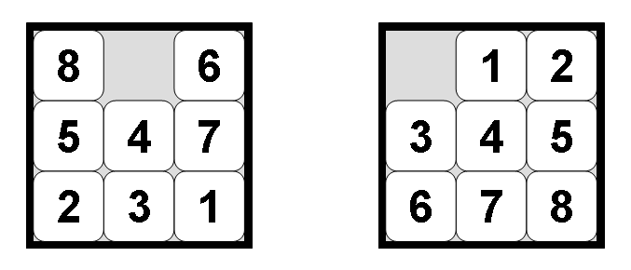
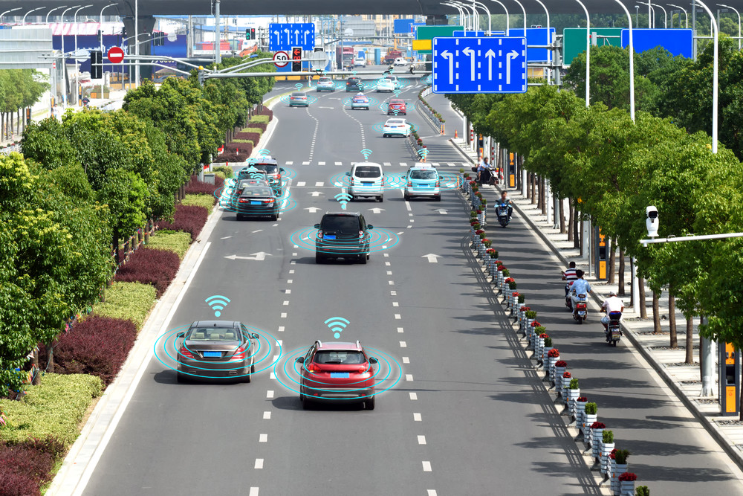
Deterministic vs. stochastic
Deterministic
The next state of the environment is completely determined by the current state and the action executed by the agent.
If the environment is deterministic except for the actions of other agents, then the environment is strategic.
Examples: 8-puzzle
Stochastic
The environment is random in nature and cannot be completely determined
Agents’ actions do not uniquely determine the outcome
Examples: driverless cars, most real-world environments

Slide 11
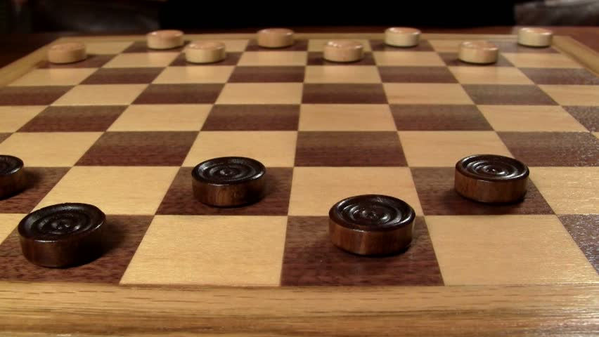

Discrete vs. continuous
Discrete
Limited number of distinct, clearly deﬁned perceptions and actions,
Example: checkers, chess
Continuous
Many actions and percepts (not a limited set)
Example: patient’s temperature and blood pressure

Slide 12
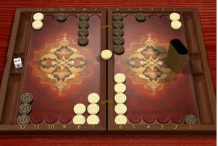
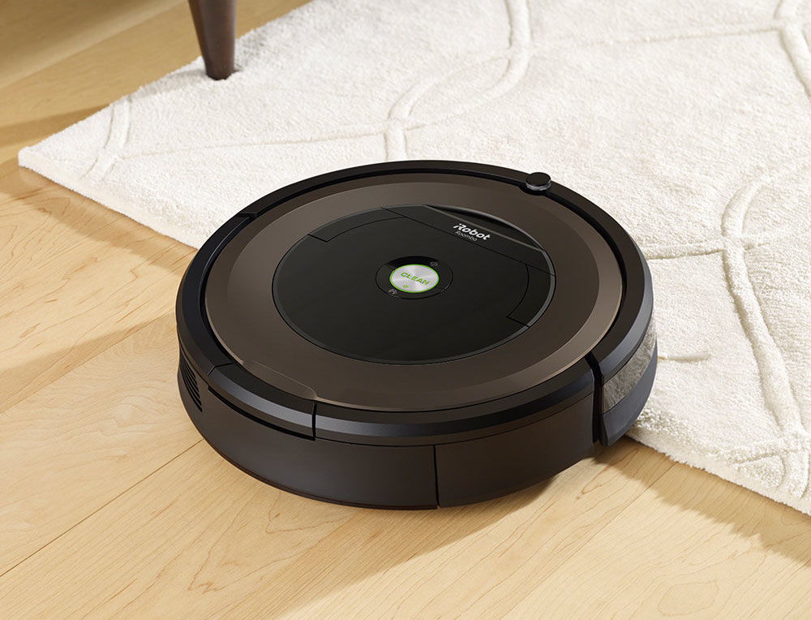
Static vs. Dynamic environment
Static
The environment is unchanged while an agent is deliberating.
Example: Backgammon
Dynamic
The environment changes.
Example: Roomba

Slide 13
Benign vs. adversarial
Benign
The environment has by itself no objective that would contradict agent’s own objectives (e.g. goals).
Example: it rains and ruins your plans to play outside but it doesn't rain just because it doesn't want you to play!
Adversarial
The environment (via other agents’ actions) has objectives that contradict yours.
Example: chess, multiplayer video games

Slide 14
Environment Types - Examples
 | Internet Shopping | Driverless Car | Backgammon | Poker
Fully observable? (vs. Imperfect info)
Deterministic? (vs. Stochastic)
Discrete? (vs. Continuous)
Static? (vs. Dynamic)
Benign? (vs. Adversarial)
Single agent? (vs. multi-agent)
Notes:
The real world is partially observable, stochastic, dynamic, continuous, and multi-agent

Slide 15
Environment Types - Examples
 | Internet Shopping | Driverless Car | Backgammon | Poker
Fully observable? (vs. Imperfect info) | No
Deterministic? (vs. Stochastic) | Partly
Discrete? (vs. Continuous) | Yes
Static? (vs. Dynamic) | Partly
Benign? (vs. Adversarial) | Yes
Single agent? (vs. multi-agent) | Yes/No (auctions)
Notes:
The real world is partially observable, stochastic, dynamic, continuous, and multi-agent

Slide 16
Environment Types - Examples
 | Internet Shopping | Driverless Car | Backgammon | Poker
Fully observable? (vs. Imperfect info) | No | No
Deterministic? (vs. Stochastic) | Partly | No
Discrete? (vs. Continuous) | Yes | No
Static? (vs. Dynamic) | Partly | No
Benign? (vs. Adversarial) | Yes | Yes
Single agent? (vs. multi-agent) | Yes/No (auctions) | No
Notes:
The real world is partially observable, stochastic, dynamic, continuous, and multi-agent

Slide 17
Environment Types - Examples
 | Internet Shopping | Driverless Car | Backgammon | Poker
Fully observable? (vs. Imperfect info) | No | No | Yes
Deterministic? (vs. Stochastic) | Partly | No | No
Discrete? (vs. Continuous) | Yes | No | Yes
Static? (vs. Dynamic) | Partly | No | Yes
Benign? (vs. Adversarial) | Yes | Yes | No
Single agent? (vs. multi-agent) | Yes/No (auctions) | No | No
Notes:
The real world is partially observable, stochastic, dynamic, continuous, and multi-agent

Slide 18
Environment Types - Examples
 | Internet Shopping | Driverless Car | Backgammon | Poker
Fully observable? (vs. Imperfect info) | No | No | Yes | No
Deterministic? (vs. Stochastic) | Partly | No | No | No
Discrete? (vs. Continuous) | Yes | No | Yes | Yes
Static? (vs. Dynamic) | Partly | No | Yes | Partly
Benign? (vs. Adversarial) | Yes | Yes | No | No
Single agent? (vs. multi-agent) | Yes/No (auctions) | No | No | No
Notes:
The real world is partially observable, stochastic, dynamic, continuous, and (sometimes) multi-agent

Slide 19
Agent types/architectures
Four basic types:
Simple reflex agents
Reflex agents with state
Goal-based agents
Utility-based agents
All these can be turned into learning agents

Slide 20
Simple reflex agents
Act on How the world is
Notes:
Simple reflex agents act only on the basis of the current percept, ignoring the rest of the percept history. The agent function is based on the condition-action rule: if condition then action.
This agent function only succeeds when the environment is fully observable. Some reflex agents can also contain information on their current state which allows them to disregard conditions whose actuators are already triggered.
Infinite loops are often unavoidable for simple reflex agents operating in partially observable environments. Note: If the agent can randomize its actions, it may be possible to escape from infinite loops.

Slide 21
Reflex agents with state (Model-based reflex agents)
Maintain a model of their environment
Act on how the world is and their model of the world
Notes:
A model-based agent can handle partially observable environments. Its current state is stored inside the agent maintaining some kind of structure which describes the part of the world which cannot be seen. This knowledge about "how the world works" is called a model of the world, hence the name "model-based agent".
A model-based reflex agent should maintain some sort of internal model that depends on the percept history and thereby reflects at least some of the unobserved aspects of the current state. Percept history and impact of action on the environment can be determined by using internal model. It then chooses an action in the same way as reflex agent.
An agent may also use models to describe and predict the behaviors of other agents in the environment.

Slide 22
Goal-based agents
Consider “what if”
Must have a model of how the environment evolves in response to actions
Act on How the world would be
Notes:
Goal-based agents further expand on the capabilities of the model-based agents, by using "goal" information. Goal information describes situations that are desirable. This allows the agent a way to choose among multiple possibilities, selecting the one which reaches a goal state. Search and planning are the subfields of artificial intelligence devoted to finding action sequences that achieve the agent's goals.

Slide 23
Utility-based agents
Like Goal-based but
Trade off multiple goals
Reason about probabilities of outcomes (utility function)
Act on how the world will likely by
Notes:
Goal-based agents only distinguish between goal states and non-goal states. It is possible to define a measure of how desirable a particular state is. This measure can be obtained through the use of a utility function which maps a state to a measure of the utility of the state. A more general performance measure should allow a comparison of different world states according to exactly how happy they would make the agent. The term utility can be used to describe how "happy" the agent is.
A rational utility-based agent chooses the action that maximizes the expected utility of the action outcomes - that is, what the agent expects to derive, on average, given the probabilities and utilities of each outcome. A utility-based agent has to model and keep track of its environment, tasks that have involved a great deal of research on perception, representation, reasoning, and learning.

Slide 24
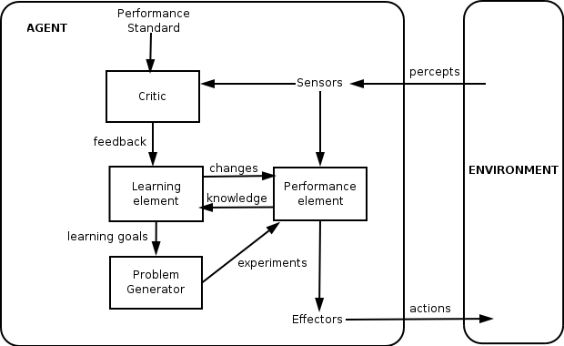
General Learning Agent
Notes:
Learning has the advantage that it allows the agents to initially operate in unknown environments and to become more competent than its initial knowledge alone might allow. The most important distinction is between the "learning element", which is responsible for making improvements, and the "performance element", which is responsible for selecting external actions.
The learning element uses feedback from the "critic" on how the agent is doing and determines how the performance element should be modified to do better in the future. The performance element is what we have previously considered to be the entire agent: it takes in percepts and decides on actions.
The last component of the learning agent is the "problem generator". It is responsible for suggesting actions that will lead to new and informative experiences. …(explore vs. exploit trade-off)

Slide 25
AI overview
Machine Learning
Speech processing
Expert Systems
Natural Language Processing
Unsupervised
Supervised/Semi-supervised
Reinforcement
Artificial Intelligence
Automated Planning, Scheduling
Inference Engine
Knowledge Base
Image recognition
Machine vision
Vision
Robotics
Solving problems by searching
Constraint Satisfaction
Information extraction
Translation
Classification, Clustering
…
…
Notes:
Areas of AI

